Slide 1
Document Classification

Slide 2
What is the role of document classification in information retrieval?

Slide 3
Classification Methods (3): Supervised learning
Introduction to Information Retrieval
Sec. 13.1
Given:
A document d
A fixed set of classes:
C = {c₁, c₂,…, c_{J}}
A training set D of documents each with a label in C
Determine:
A learning method or algorithm which will enable us to learn a classifier γ
For a test document d, we assign it the class
γ(d) ∈ C

Slide 4
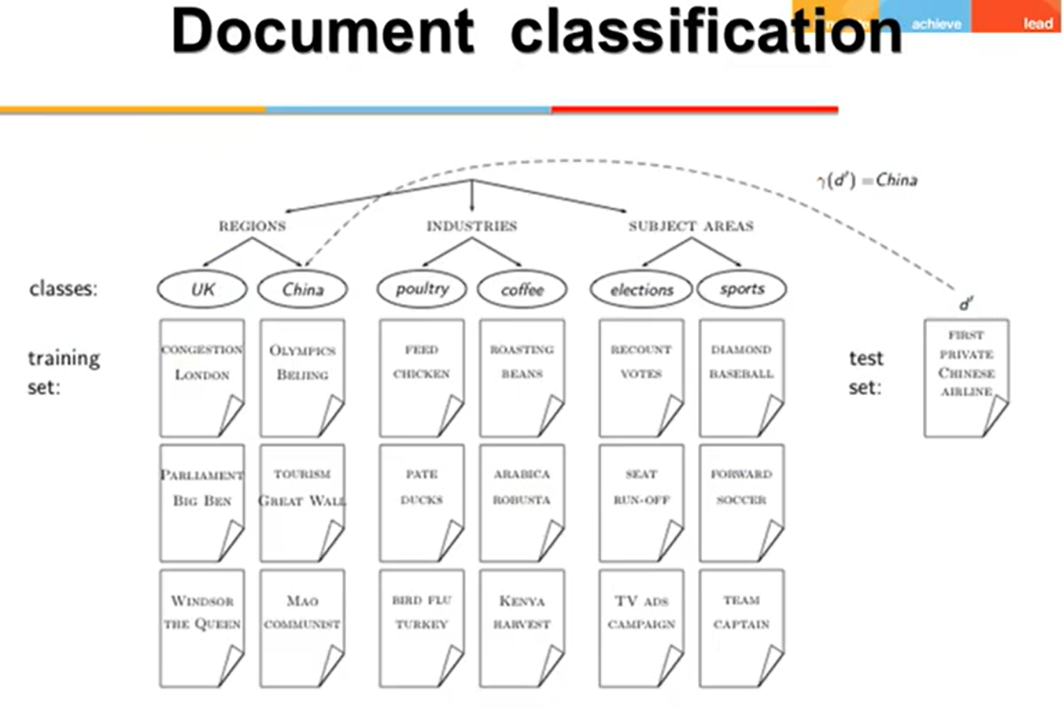

Slide 5
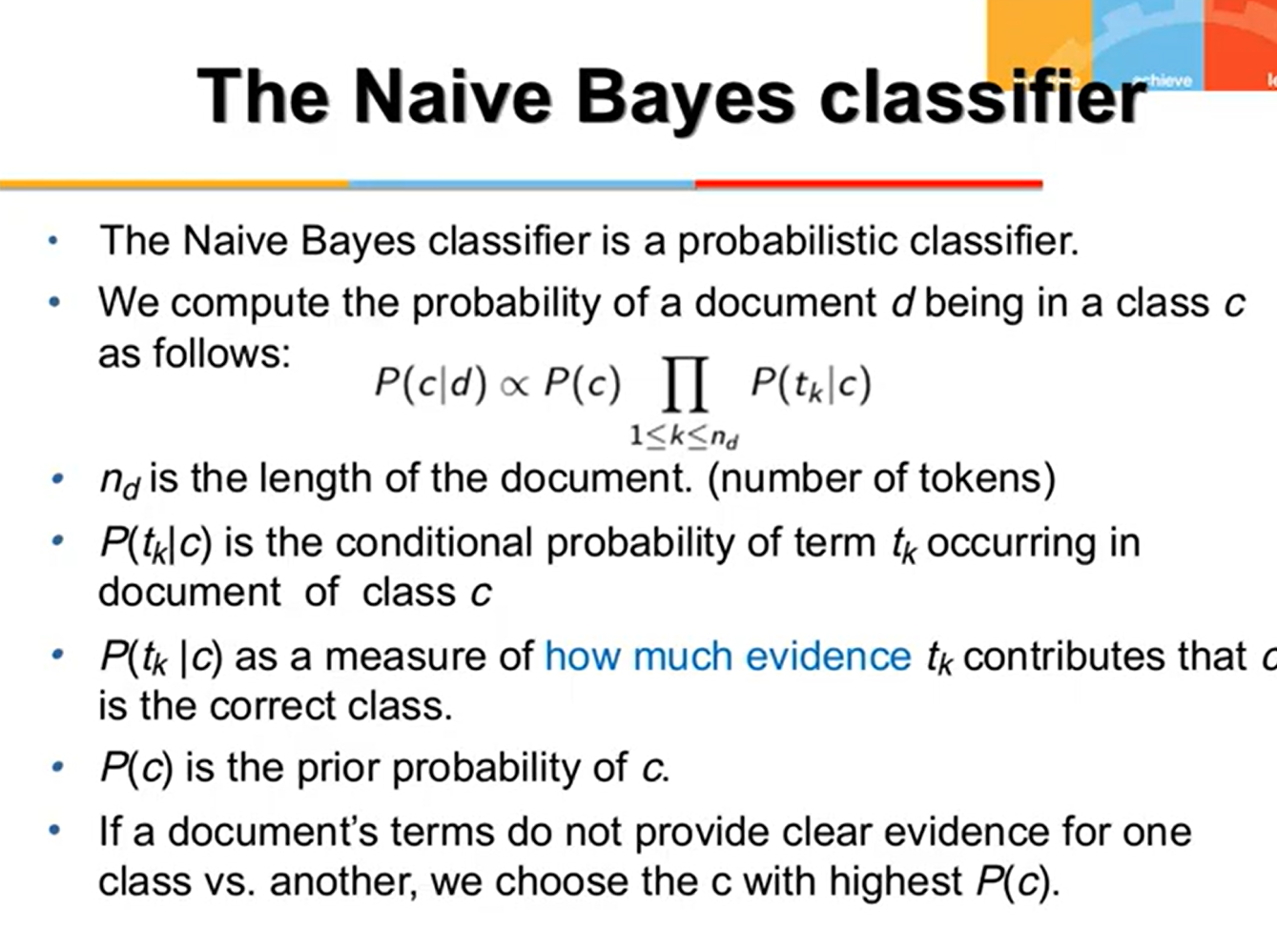

Slide 6
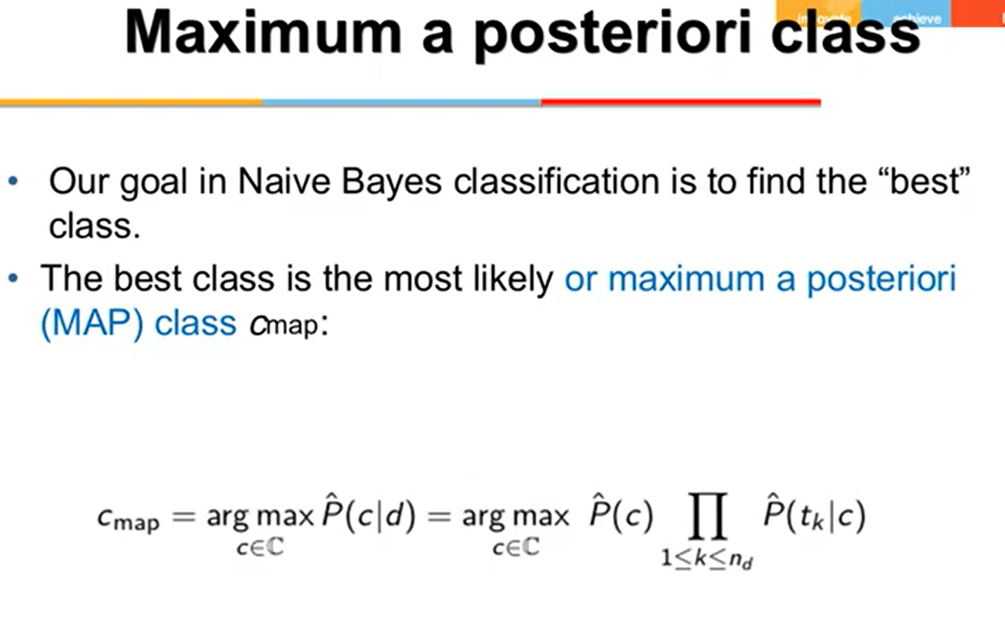

Slide 7
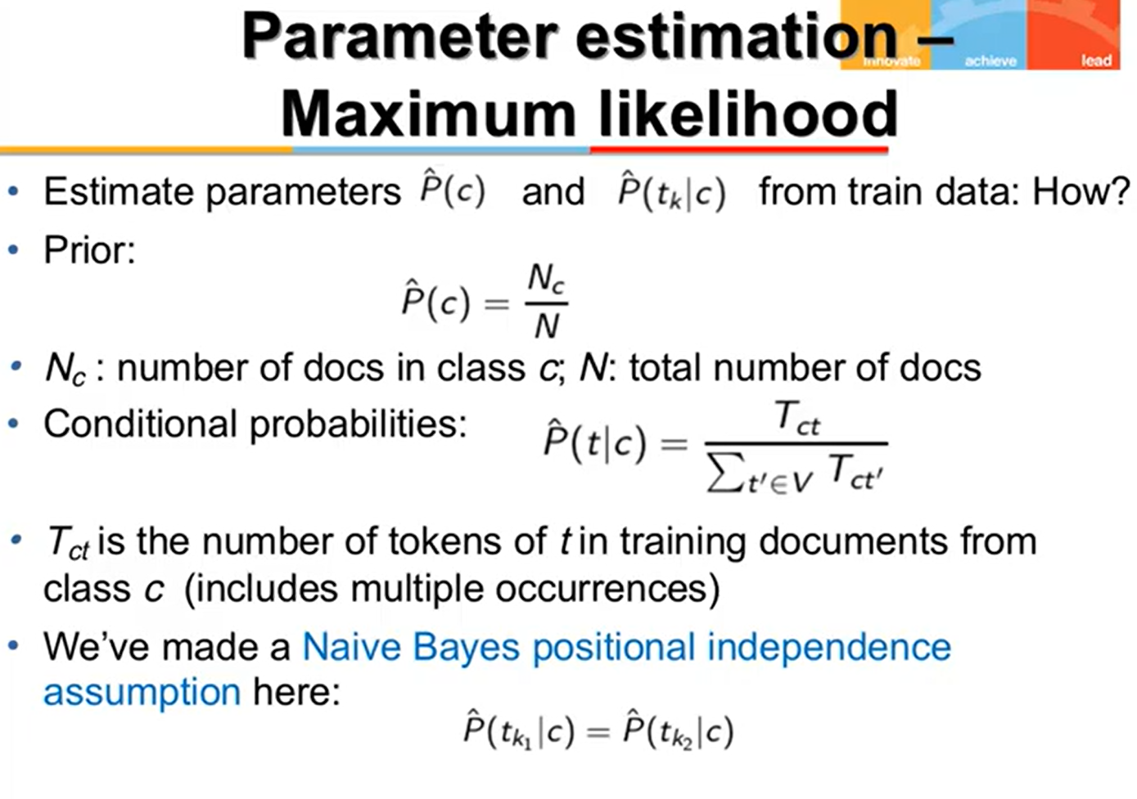

Slide 8
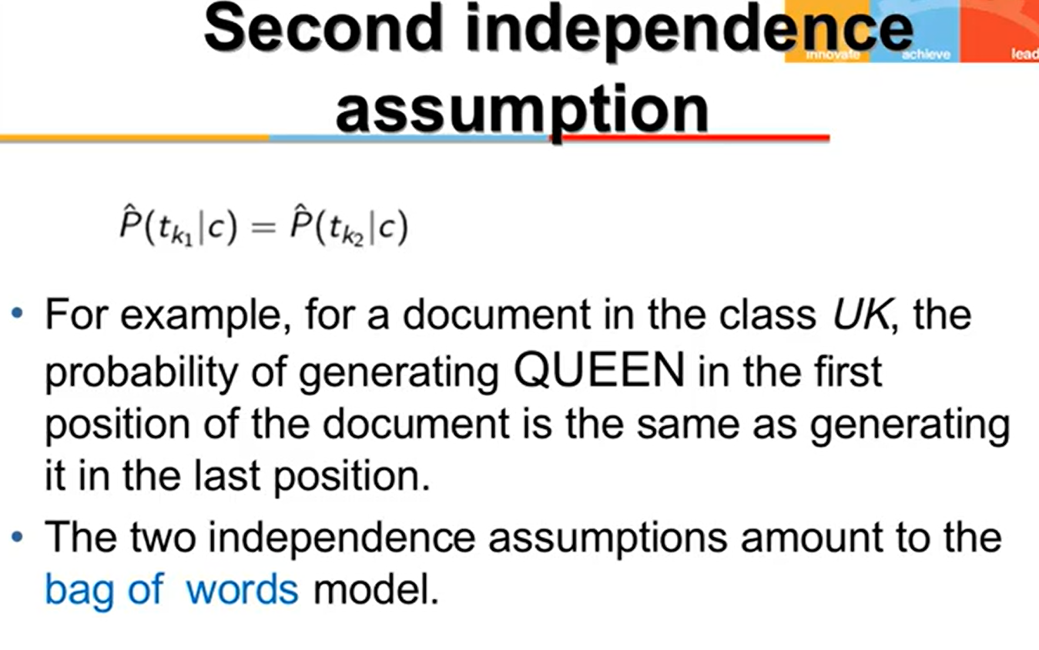

Slide 9
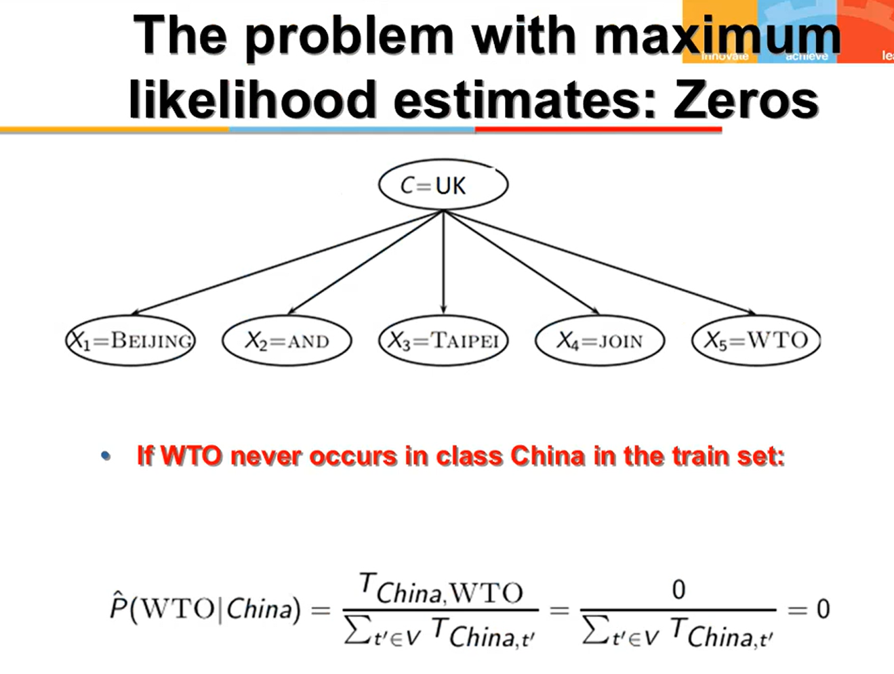

Slide 10
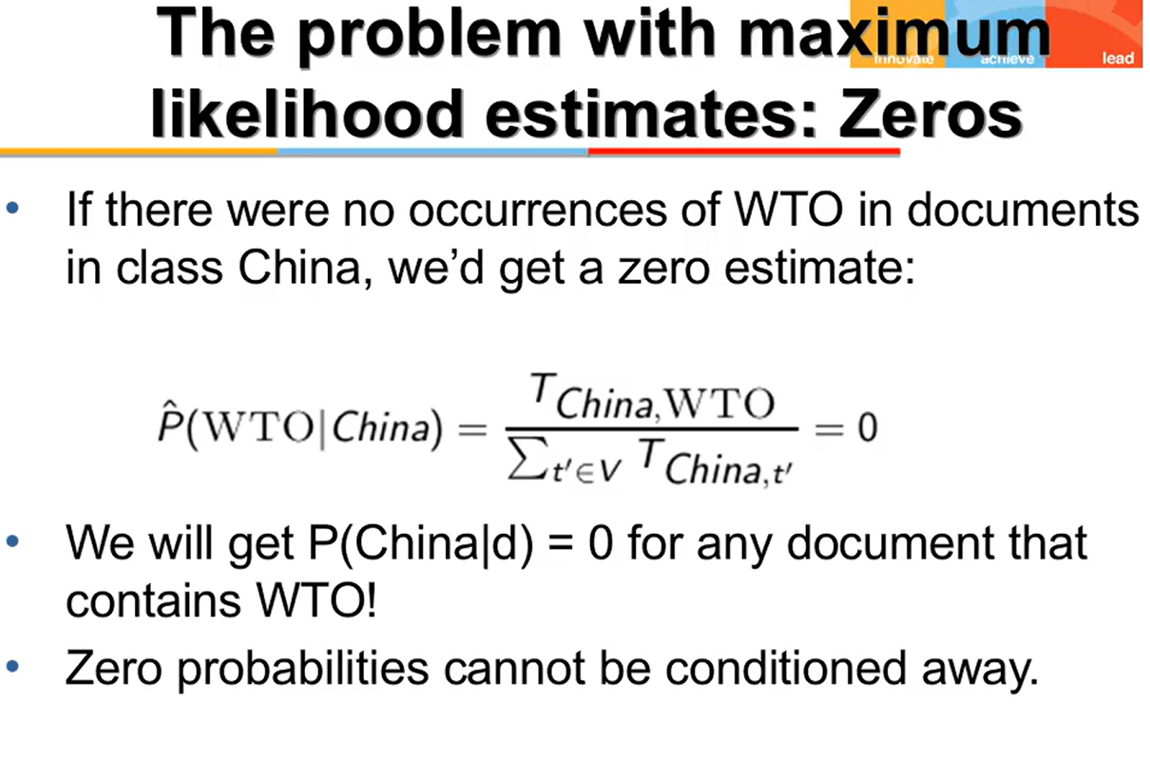

Slide 11
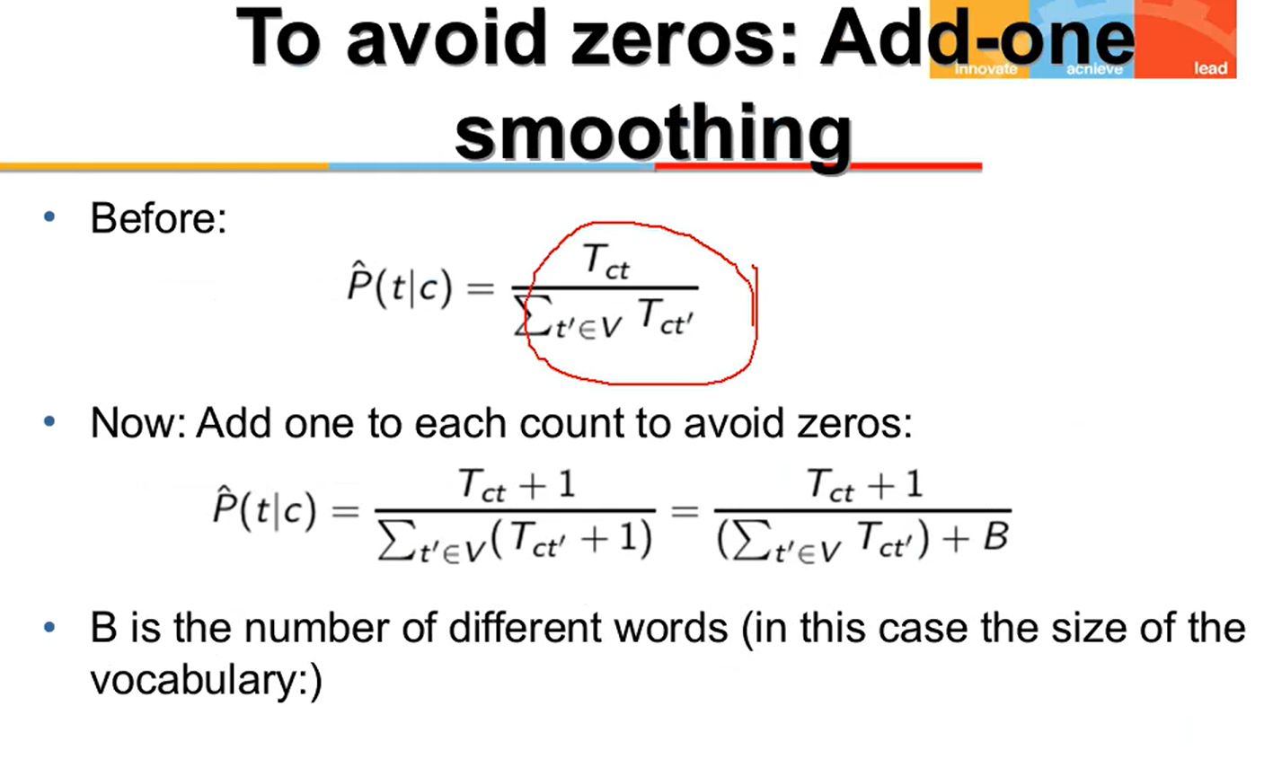

Slide 13
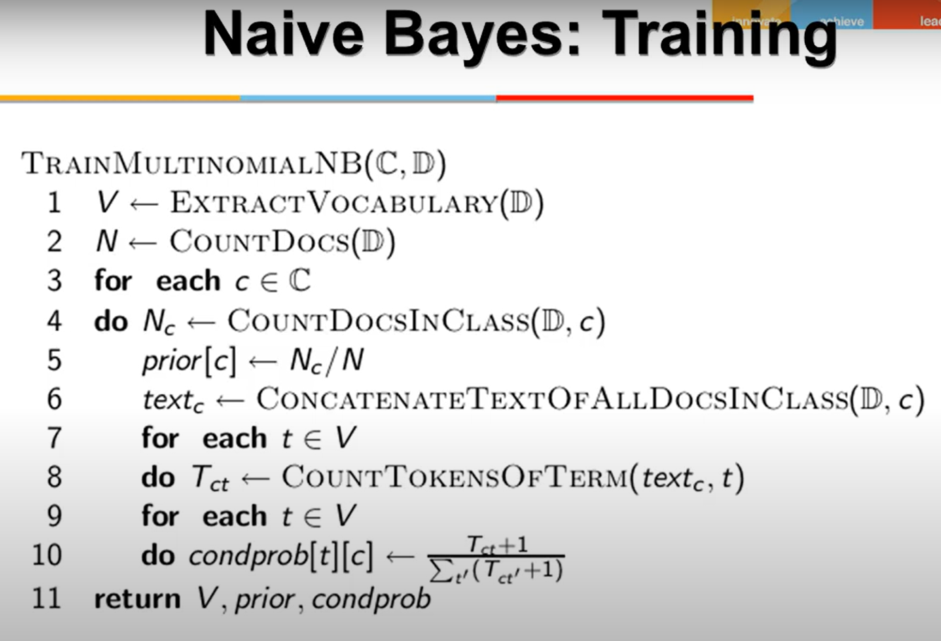

Slide 14
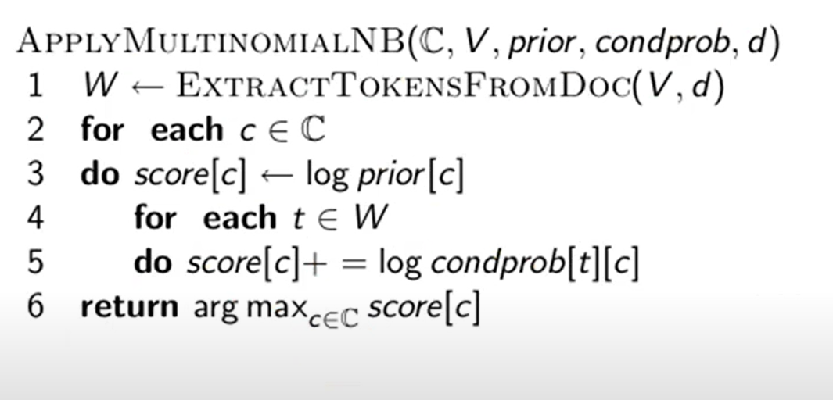

Slide 15
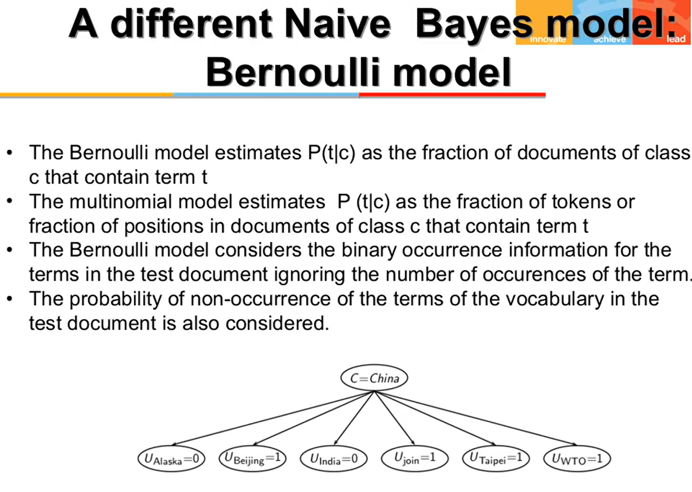

Slide 16
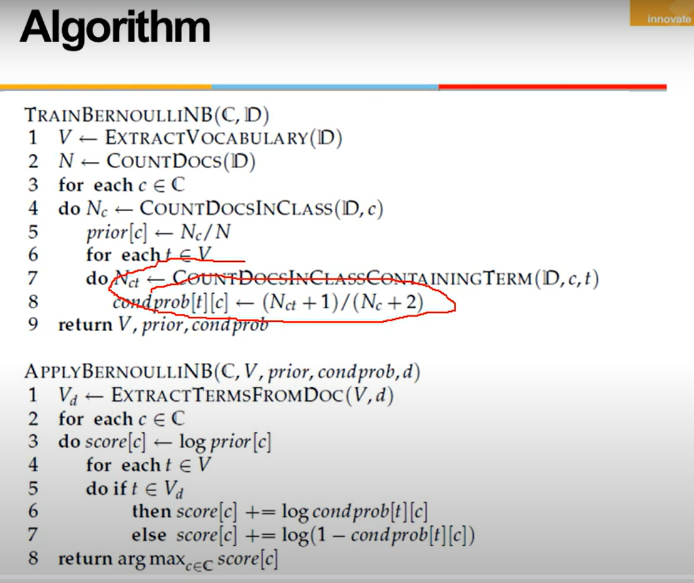

Slide 17
Test doc: “buy cheap dinner”
Doc id | cheap | buy | banking | dinner | the | class
1 | 0 | 0 | 0 | 0 | 1 | Not spam
2 | 1 | 0 | 1 | 0 | 1 | spam
3 | 0 | 0 | 0 | 0 | 1 | Not spam
4 | 1 | 0 | 1 | 0 | 1 | spam
5 | 1 | 1 | 0 | 0 | 1 | spam
6 | 0 | 0 | 1 | 0 | 1 | Not spam
7 | 0 | 1 | 1 | 0 | 1 | Not spam
8 | 0 | 0 | 0 | 0 | 1 | Not spam
9 | 0 | 0 | 0 | 0 | 1 | Not spam
10 | 1 | 1 | 0 | 1 | 1 | Not spam

